Slide 1
Fraud Detection in Financial Transactions
Leveraging Machine Learning and NLP
Ahmed Ali Yahya
Elsayed Osama Elsayed
Ayman Mohamed Abdelhady
Mhmoud Mohamed
Omnia Ashraf eldeeb

Slide 2
Ahmed Ali Yahya
Elsayed Osama Elsayed
Ayman Mohamed Abdelhady
Mhmoud Mohamed
Omnia Ashraf eldeeb
Team Member Project
Team Member | Role | week
Ahmed Ali Yahya | Data Collection & Preprocessing | Week 1
Elsayed Osama Elsayed | Statistical Analysis & ML Development | Week 2
Ayman Mohamed Abdelhady | Streamlit & NLP | Week 3
Mahmoud Mohamed | Synthetic Data with GANs | Week 4
Omnia Ashraf eldeeb | MLOps & final report and presentation | Week 4

Slide 3
Project Overview
Objective: Detect fraudulent transactions using machine learning techniques.
Scope: Analyze financial transaction data and deploy a fraud detection model

Slide 4
Week 1 - Data Collection and Preprocessing
Tasks:
Collected financial transaction data (fraudulent and non-fraudulent).
Cleaned and preprocessed data (addressed missing values, normalized features).
Tools: Python (Pandas, NumPy).
Deliverable: Cleaned dataset and preprocessing.

Slide 5
Week 2 - Statistical Analysis and Machine Learning
Tasks:
Conducted statistical analysis to understand feature distributions.
Developed classification models (e.g., Logistic Regression, Random Forest).
Tools: Python (Scikit-learn, Statsmodels).
Deliverable: Statistical analysis report and performance metrics of models.

Slide 6
Week 3 - Advanced Techniques and Streamlit
Tasks:
Applied NLP techniques to analyze transaction descriptions.
Deployed the fraud detection model with Streamlit.
Tools: Streamlit, Python (NLTK, SpaCy).
Deliverable: Enhanced model with NLP and Azure deployment setup.

Slide 7
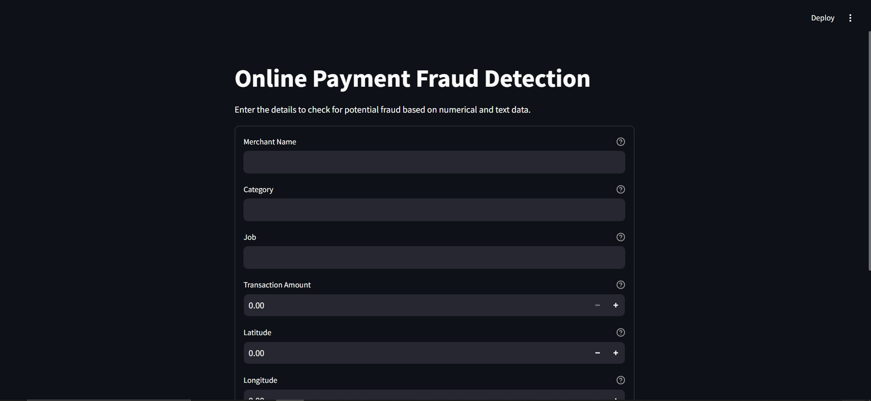

Slide 8
Week 4 - MLOps, GANs, and Final Presentation
Tasks:
Managed models using MLflow for tracking and monitoring.
Implemented a GAN to generate synthetic fraud data.
Tools: MLflow, TensorFlow/PyTorch, Azure services.
Deliverable: Deployed fraud detection model with synthetic data.

Slide 9
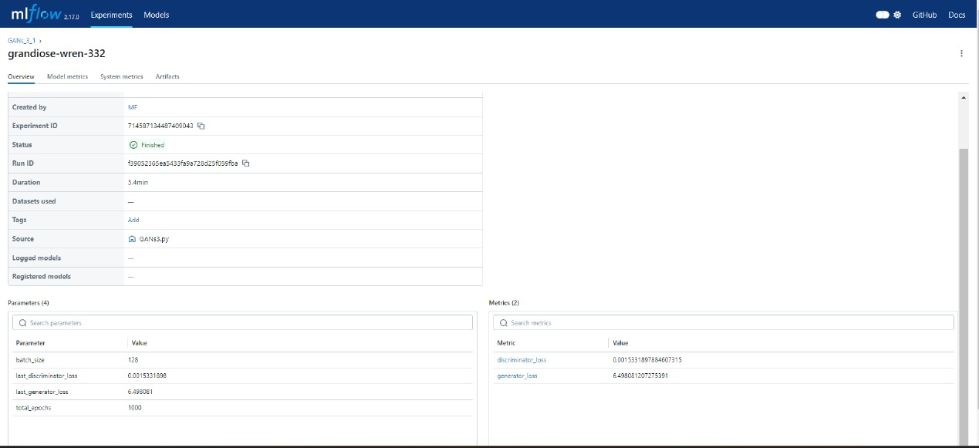
Results
Performance Metrics:
Accuracy, Precision, Recall, F1 Score (include graphs).
Key Findings: Insights from data analysis and model performance.

Slide 10
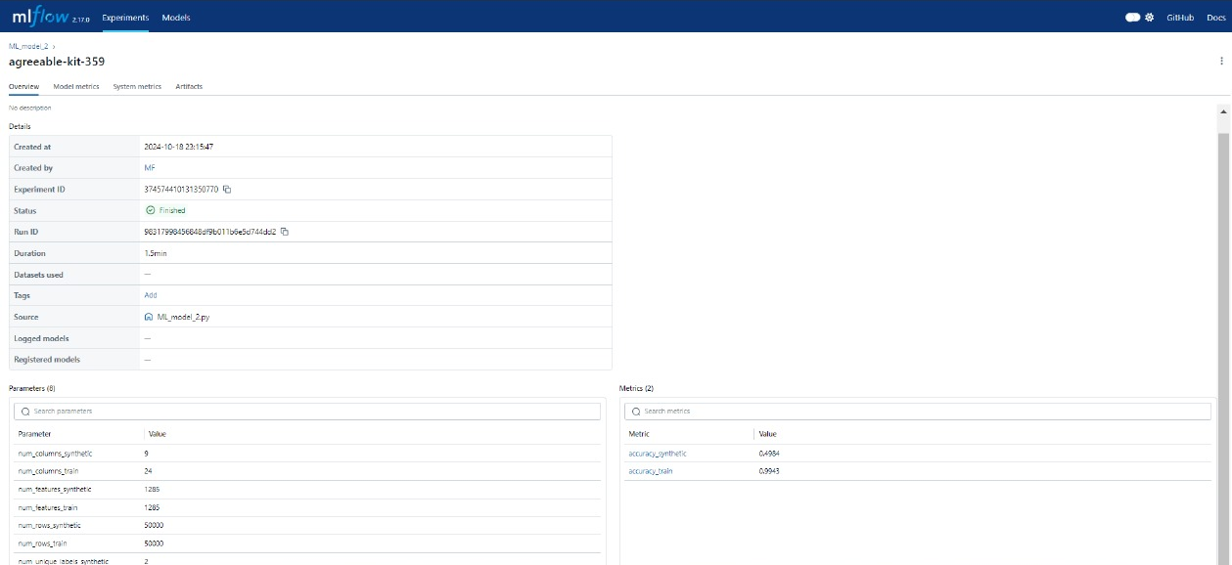
Results
Performance Metrics:
Accuracy, Precision, Recall, F1 Score (include graphs).
Key Findings: Insights from data analysis and model performance.

Slide 11
Challenges and Solutions
Challenges Encountered: Data imbalance, model deployment issues.
Solutions Implemented: Oversampling techniques, cloud deployment practices.

Slide 12
Conclusion
The "Fraud Detection in Financial Transactions" project successfully demonstrates the application of machine learning and natural language processing to tackle the pressing issue of fraudulent transactions. Through a structured approach over four weeks, we achieved the following key outcomes:
Data Collection and Preprocessing: We gathered and cleaned a comprehensive dataset, ensuring high data quality through effective preprocessing techniques. This step laid a strong foundation for subsequent analysis.
Statistical Analysis and Model Development: By conducting thorough statistical analyses, we gained insights into the features associated with fraudulent activities. We developed and evaluated several classification models, including Logistic Regression and Random Forest, which yielded promising performance metrics in detecting fraud.
Advanced Techniques and Deployment: The integration of NLP techniques enhanced our model's capability to analyze transaction descriptions, providing deeper insights into potential fraud indicators. The deployment of the fraud detection model on Azure facilitated real-time monitoring and scalability.
MLOps and Synthetic Data Generation: Utilizing MLflow for model tracking ensured efficient management of the machine learning lifecycle. Additionally, implementing Generative Adversarial Networks (GANs) to create synthetic fraud data addressed challenges related to data imbalance, further improving model robustness.
Overall, this project highlights the effectiveness of combining statistical methods, machine learning, and modern deployment practices to create a reliable fraud detection system. Future enhancements could focus on exploring advanced deep learning techniques, continuous model improvement, and integrating feedback loops for ongoing performance optimization. This initiative not only contributes to financial security but also paves the way for further research and development in fraud detection methodologies.

Slide 13

Q&A

